Slide 1
Chi-Square Goodness-of-Fit Test
Audity Ghosh

Slide 2
Chi-Square Goodness-of-Fit Test
The Chi-Square Goodness-of-Fit Test is a statistical method used to check whether the observed data matches the expected data based on a certain hypothesis. It helps answer questions like:
  Is a die fair (i.e., do all sides appear equally)?
  Do customers prefer different product colors equally?
  Are the proportions of a population following a known distribution?

Slide 3
What Are Observed and Expected Frequencies?
Observed Frequency (Oi​):
  The actual number of occurrences recorded in each category.
  This is collected from real-world data or experiments.
Expected Frequency (Ei​):
  The theoretical count we expect in each category based on an assumed probability distribution (like fairness or equal proportions).
  This is calculated based on a null hypothesis that assumes a specific pattern or balance in the data.

Slide 4
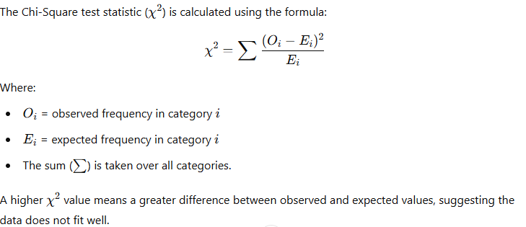
Understanding the Formula

Slide 5
Degree of Freedom
The degrees of freedom (df) = (number of categories−1) -number of estimated parameters
Number of Categories: This refers to the total number of categories or groups in your dataset.
Number of Estimated Parameters: In most cases for a simple Chi-square test, this value is usually zero. However, in more complex models (like logistic regression or when accounting for certain constraints), you may estimate parameters (like means or proportions) that will affect the degrees of freedom.

Slide 6
WORKING PROCEDURE
Step 1: Collect the observed data (frequencies).
Step 2: Define the expected distribution (e.g., uniform, normal).
Step 3: Compute the expected frequencies based on the distribution.
Step 4: Calculate the Chi-square statistic.
Step 5: Compare the statistic with the Chi-square distribution critical value to accept or reject the null hypothesis.

Slide 7
Step-by-Step Example: Is a Coin Fair?
Step 1: Define the Hypothesis
We are testing whether a coin is fair, meaning heads and tails should appear equally.
Null Hypothesis (H0): The coin is fair, and both heads and tails occur with equal probability.
Alternative Hypothesis (H1): The coin is not fair, meaning one side appears more often than expected.

Slide 8
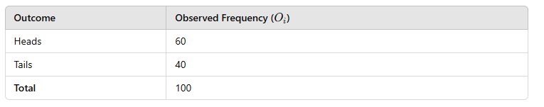
Step-by-Step Example: Is a Coin Fair?
Step 2: Collect the Data
You flip a coin 100 times and record the results:

Slide 9
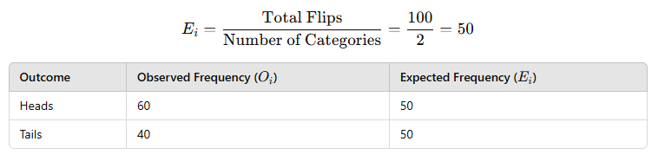
Step-by-Step Example: Is a Coin Fair?
Step 3: Calculate Expected Frequencies
If the coin is fair, the expected frequency for each outcome is:

Slide 10
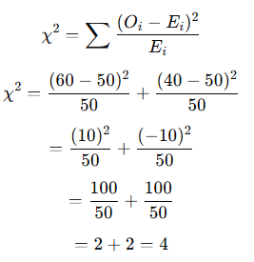
Step-by-Step Example: Is a Coin Fair?
Step 4: Compute the Chi-Square Statistic
Using the formula:

Slide 11
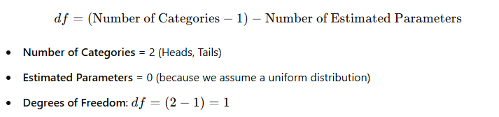
Step-by-Step Example: Is a Coin Fair?
Step 5: Determine the Degrees of Freedom (df)

Slide 12
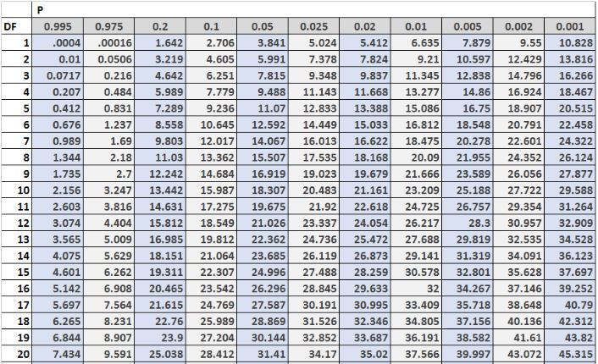
Step-by-Step Example: Is a Coin Fair? (Chi-Square Table)

Slide 13
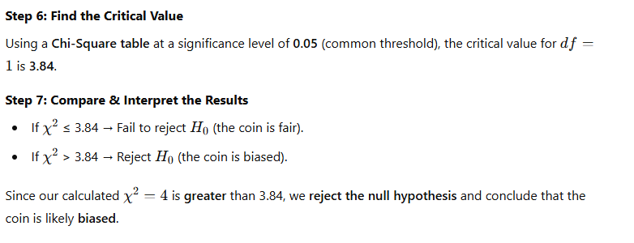
Step-by-Step Example: Is a Coin Fair?

Slide 14
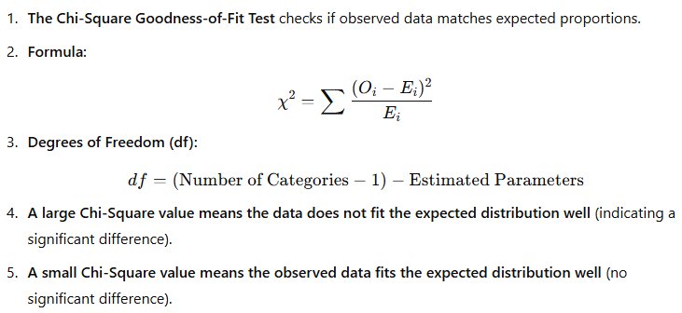
Key Takeaways

Slide 15
Key Takeaways
✅ If observed values ≈ expected values, the data fits the expected model, and the null hypothesis is not rejected.
❌ If observed values differ significantly from expected values, we reject the null hypothesis, suggesting a pattern or bias in the data.

